Slide 1

6th Grade Accelerated Math
Unit 12, Lesson 8 Calculating Percent Error and Simple Interest Volume 2, pg. 253

Slide 2


Benchmark
MA.7.AR.3.1
Apply previous understanding of percentages and ratios to solve multi-step, real-world percent problems.
volume 2, pg. 253

Slide 3
Integrated Mathematical Thinking and Reasoning Standards
MA.K12.MTR.3.1 Complete tasks with mathematical fluency.
MA.K12.MTR.6.1 Assess the reasonableness of solutions.
MA.K12.MTR.7.1 Apply mathematics to real-world contexts.
volume 2, pg. 253

Slide 4

Learning Targets
I can find percent error.
I can solve problems that involve simple interest.
volume 2, pg. 253

Slide 5

Warm-Up
volume 2, pg. 254

Slide 6
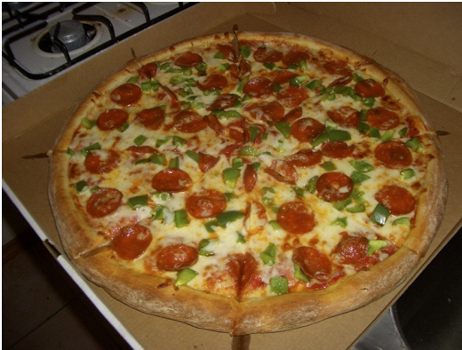
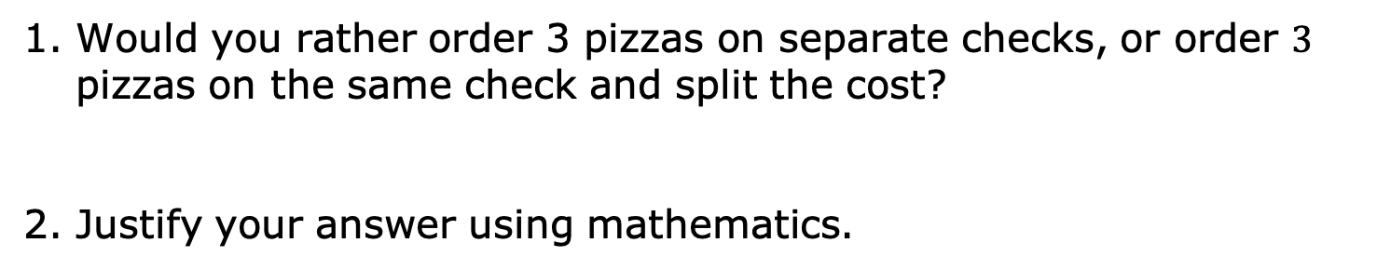
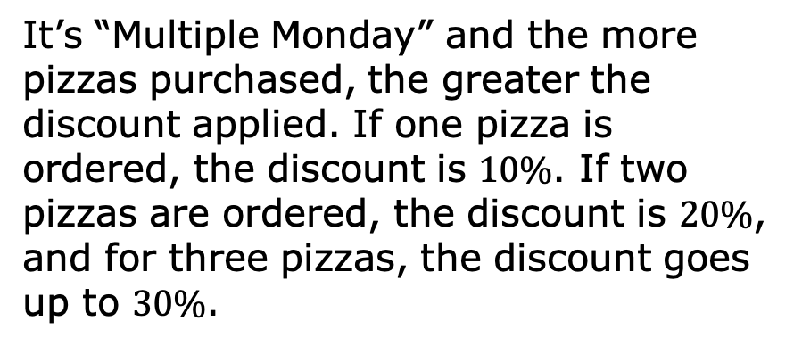
12.8.1 Warm-Up: Would You Rather?
It’s “Multiple Monday” and the more pizzas purchased, the greater the discount applied. If one pizza is ordered, the discount is $10\%$. If two pizzas are ordered, the discount is $20\%$, and for three pizzas, the discount goes up to $30\%$.
Would you rather order 3 pizzas on separate checks, or order $3$ pizzas on the same check and split the cost?
Justify your answer using mathematics.
volume 2, pg. 254

Slide 7

Exploration
volume 2, pg. 254

Slide 8

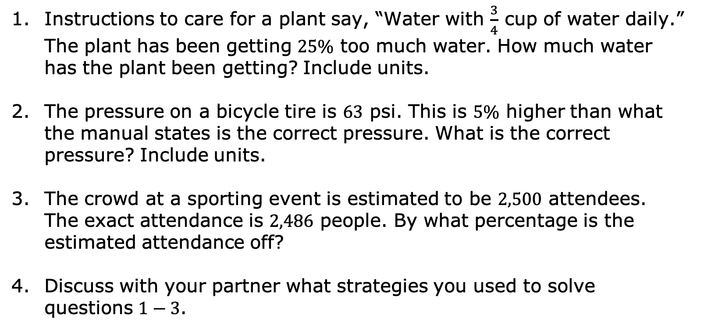
12.8.2 Exploration: Estimate vs. Actual
Instructions to care for a plant say, “Water with $\frac{3}{4}$ cup of water daily.” The plant has been getting $25\%$ too much water. How much water has the plant been getting? Include units.
The pressure on a bicycle tire is $63$ psi. This is $5\%$ higher than what the manual states is the correct pressure. What is the correct pressure? Include units.
The crowd at a sporting event is estimated to be $2,500$ attendees. The exact attendance is $2,486$ people. By what percentage is the estimated attendance off?
Discuss with your partner what strategies you used to solve questions $1−3$.
volume 2, pg. 254

Slide 9

Guided Instruction
volume 2, pg. 255

Slide 10

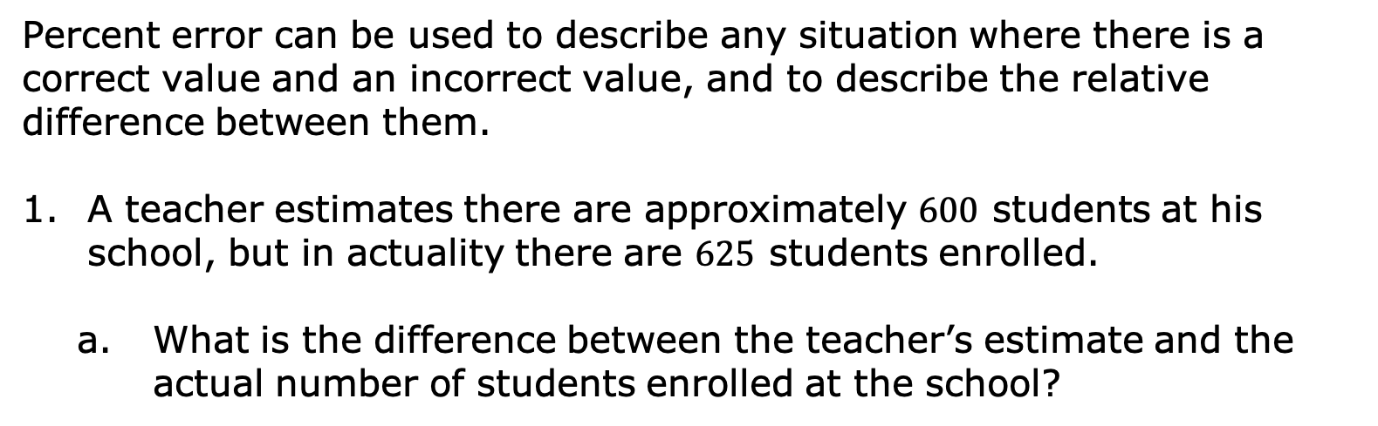
12.8.3 Guided Instruction: Percent Error
Percent error is the difference between the estimated number and the actual number as a percentage of the actual value.
Percent error can be used to describe any situation where there is a correct value and an incorrect value, and to describe the relative difference between them.
A teacher estimates there are approximately $600$ students at his school, but in actuality there are $625$ students enrolled.
What is the difference between the teacher’s estimate and the actual number of students enrolled at the school?
volume 2, pg. 255

Slide 11
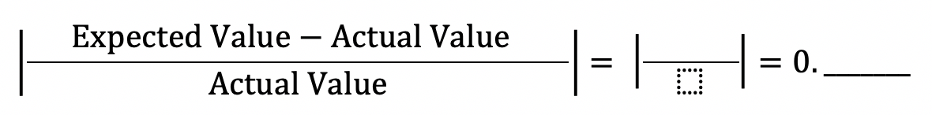

Using the definition of percent error, finish filling out the ratio of the situation.
The percent error in the teacher’s estimate is ____$\%$.
volume 2, pg. 255

Slide 12
Discuss with your partner why the percent error is positive. Summarize your discussion.
volume 2, pg. 255

Slide 13
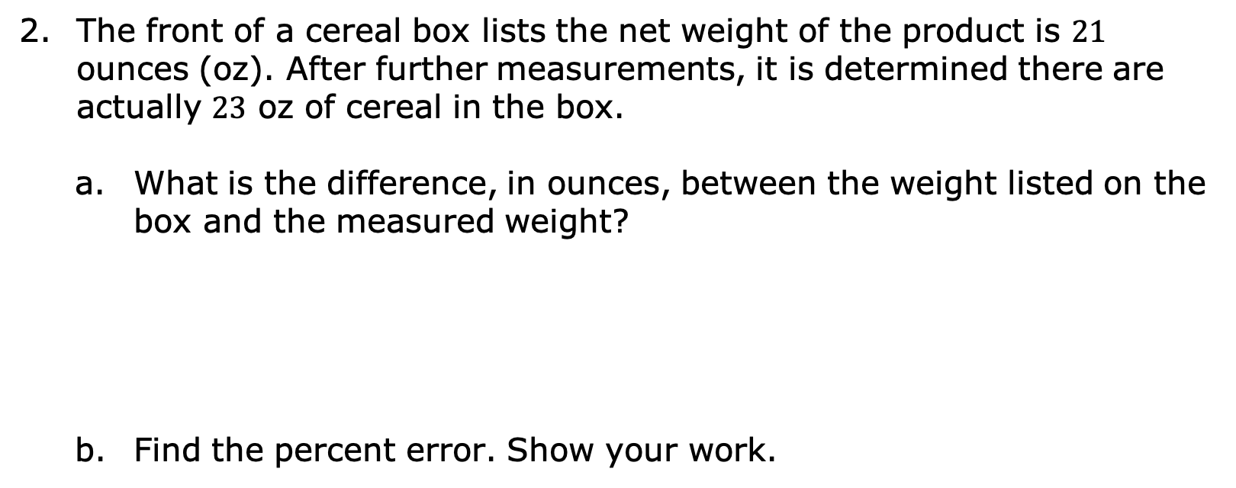
The front of a cereal box lists the net weight of the product is $21$ ounces (oz). After further measurements, it is determined there are actually $23$ oz of cereal in the box.
What is the difference, in ounces, between the weight listed on the box and the measured weight?
Find the percent error. Show your work.
volume 2, pg. 255

Slide 14

Guided Practice
volume 2, pg. 256

Slide 15

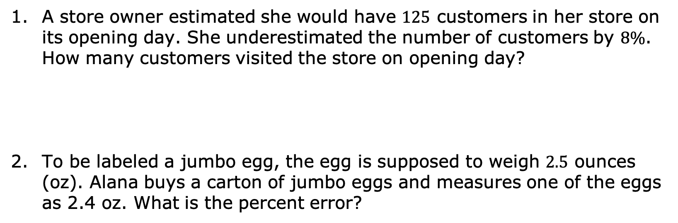
12.8.4 Guided Practice: Percent Error
A store owner estimated she would have $125$ customers in her store on its opening day. She underestimated the number of customers by $8\%$. How many customers visited the store on opening day?
To be labeled a jumbo egg, the egg is supposed to weigh $2.5$ ounces (oz). Alana buys a carton of jumbo eggs and measures one of the eggs as 2.4 oz. What is the percent error?
volume 2, pg. 256

Slide 16
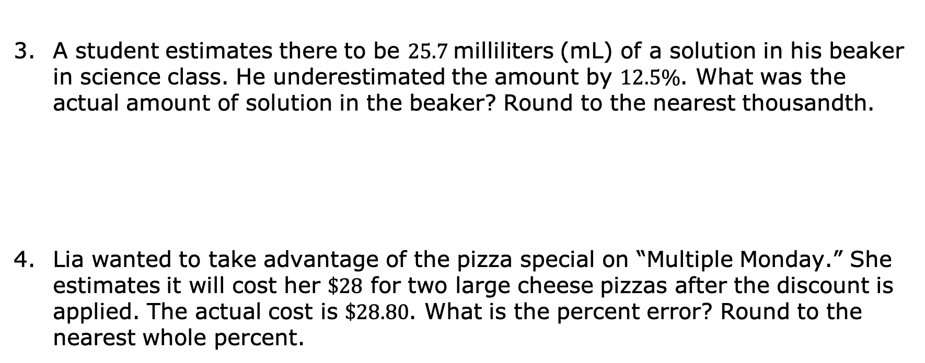
A student estimates there to be $25.7$milliliters (mL) of a solution in his beaker in science class. He underestimated the amount by $12.5\%$. What was the actual amount of solution in the beaker? Round to the nearest thousandth.
Lia wanted to take advantage of the pizza special on “Multiple Monday.” She estimates it will cost her $\$28$ for two large cheese pizzas after the discount is applied. The actual cost is $\$28.80$. What is the percent error? Round to the nearest whole percent.
volume 2, pg. 256

Slide 17
Guided Instruction
volume 2, pg. 257

Slide 18
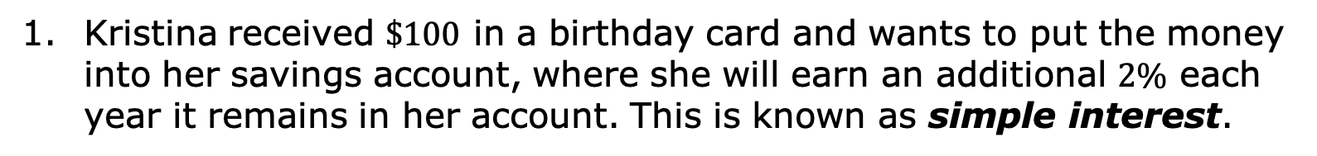
12.8.5 Guided Instruction: Simple Interest
Kristina received $\$100$ in a birthday card and wants to put the money into her savings account, where she will earn an additional $2\%$ each year it remains in her account. This is known as simple interest.
Simple interest is a method of computing interest. Interest is computed from the (original) principal alone, no matter how much money has accrued so far.
volume 2, pg. 257

Slide 19
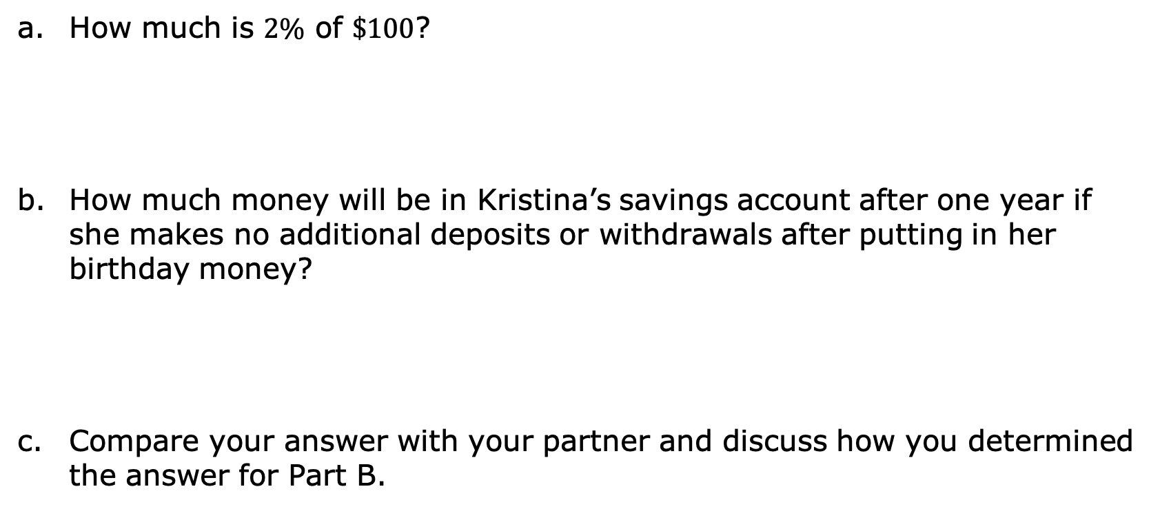
How much is $2\%$ of $\$100$?
How much money will be in Kristina’s savings account after one year if she makes no additional deposits or withdrawals after putting in her birthday money?
Compare your answer with your partner and discuss how you determined the answer for Part B.
volume 2, pg. 257

Slide 20
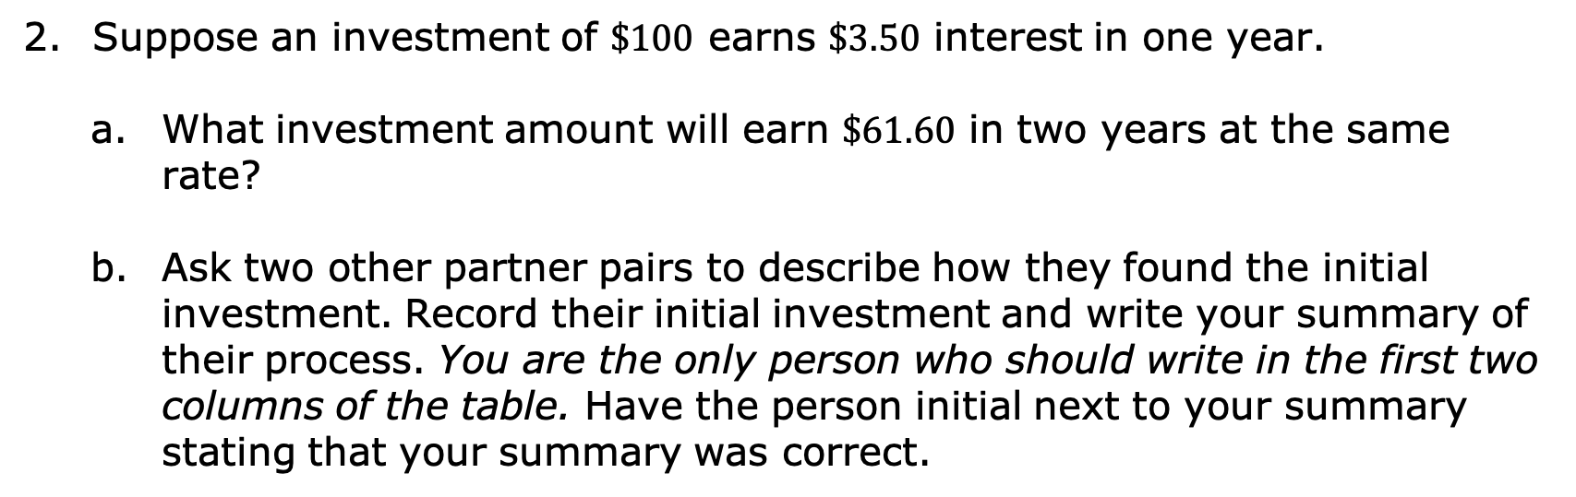
Suppose an investment of $\$100$ earns $\$3.50$ interest in one year.
What investment amount will earn $\$61.60$ in two years at the same rate?
Ask two other partner pairs to describe how they found the initial investment. Record their initial investment and write your summary of their process. You are the only person who should write in the first two columns of the table. Have the person initial next to your summary stating that your summary was correct.
Initial Investment | My Summary of Their Reason | Initials
volume 2, pg. 257

Slide 21
Review the initial investments and reasons provided by other partner pairs. If necessary, fix any mistakes you and your partner made.
volume 2, pg. 257

Slide 22

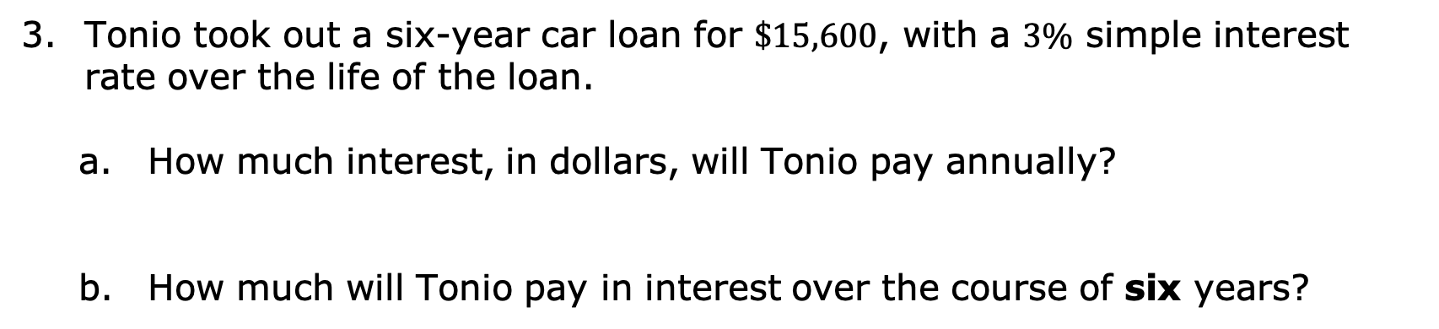
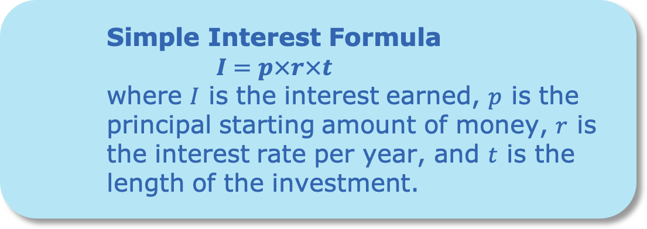
Simple Interest Formula
$$I=p×r×t$$
where $I$ is the interest earned, $p$ is the principal starting amount of money, $r$ is the interest rate per year, and $t$ is the length of the investment.
Tonio took out a six-year car loan for $\$15,600$, with a $3\%$ simple interest rate over the life of the loan.
How much interest, in dollars, will Tonio pay annually?
How much will Tonio pay in interest over the course of six years?
volume 2, pg. 258

Slide 23
What is the total amount Tonio will pay back at the end of his six-year loan?
Explain why the total amount Tonio will have paid back by the end of his loan is more than the loan amount he borrowed.
volume 2, pg. 258

Slide 24

Wrap-Up
volume 2, pg. 259

Slide 25
12.8.6 Wrap-Up: Reflection
In this unit, you have learned multiple concepts about percentages and proportional relationships, including those listed below.
Solving real-world problems using proportions
Solving discount, markup, tax, tip, and fees problems
Finding percentage of increase and decrease
Finding percent error
Solving problems involving simple interest
volume 2, pg. 259

Slide 26
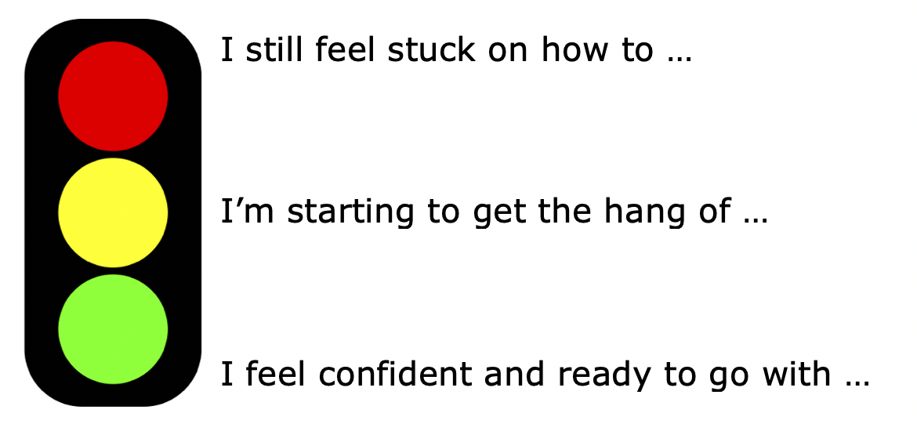
Use the stoplight reflection below to share how you are feeling about each of the concepts at this point.
volume 2, pg. 259

